Slide 1
Dry Run Creek: Urban vs. Rural Surficial Water Quality Variability
Nick Bosshart and Austin Cox

Slide 2
Urban vs. Rural Surficial Water Quality Variability of Dry Run Creek
The difference in water characteristics during transit through Cedar Falls:
Urban runoff,
Adjacent construction
Artificial banks
Storm drains
Sump drainage
Commercial pollution

Slide 3
Study Sub-Set: Site 4: Water Quality Trends, Stagnant Pool vs. Downstream
Differences in traits?
T
pH
TDS
D.O.
B.O.D.

Slide 4
Water Quality Influence

Slide 5
Non-point source, turned point source

Slide 7
Rural-Site #4

Slide 13
Urban- Site #8

Slide 16
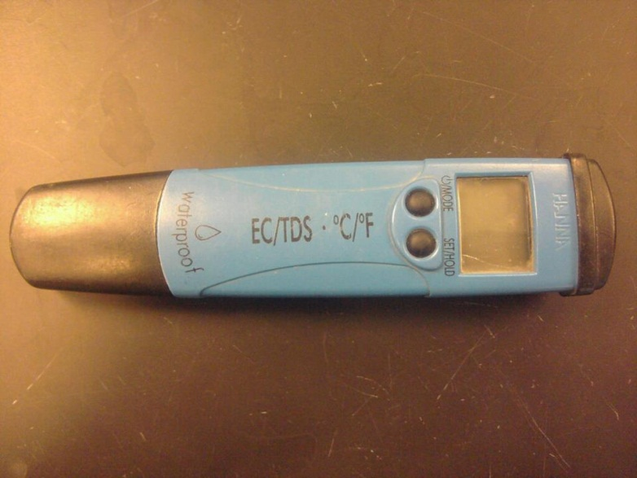
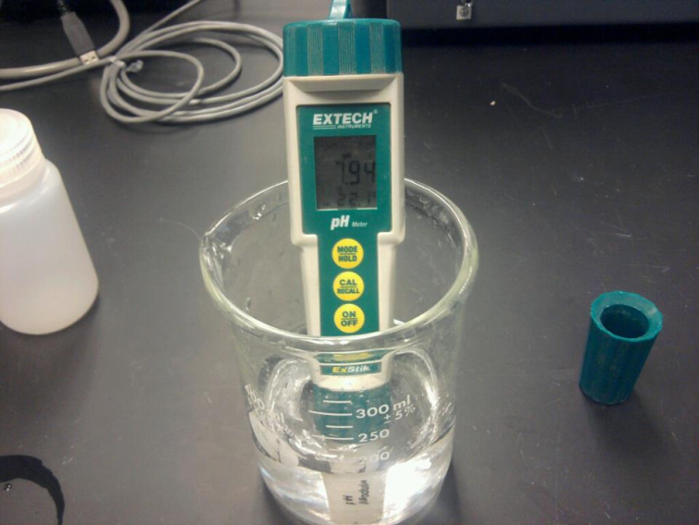
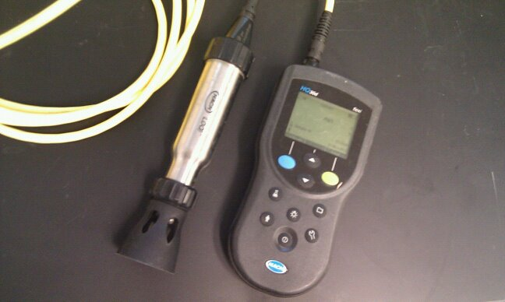
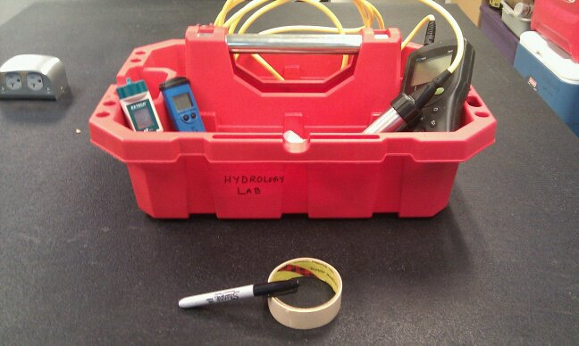
Field Methods
Temp
Total Dissolved Solids
Dissolved Oxygen
pH

Slide 17
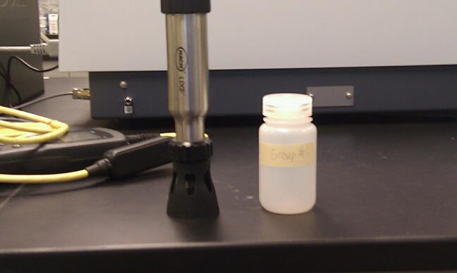
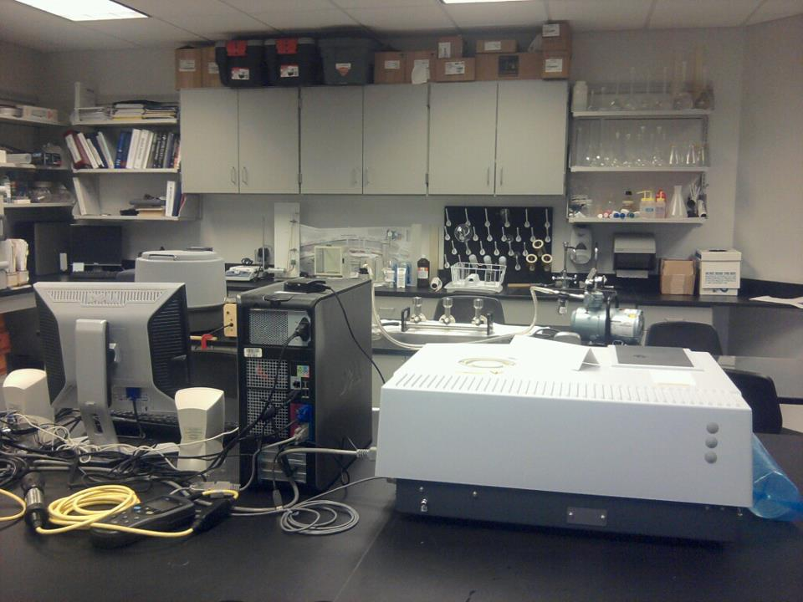
Lab Methods
5th day D.O.
Biochemical Oxygen Demand

Slide 18
Results: Temperature

Slide 19
Discussion: Temperature Results
Site 8: consistently higher in temp
Site 4: no notable difference in temp from
stagnant pool to downstream
Significant drop in temperature following rain event (both sites 4 & 8)
Temp. trend: increasing temperature during transit through urban
environment

Slide 20
Results: Dissolved oxygen

Slide 21
Discussion: D.O. Results
Dissolved oxygen content consistently higher at
site 8 (with the exception of our last data set)
Site 4: No notable differences in D.O. between
stagnant pool and downstream
Significant drop in D.O. content at both Sites 4 & 8 after rain event
D.O. trend of increasing content during transit through urban environment

Slide 22
Results: pH

Slide 23
Discussion: pH Results
Site 4: No notable difference in pH between
stagnant pool and downstream, with the
exception of our last data set
Site 8: Consistently higher pH, with the exception of our last data set
pH lowered with rain event
pH trend of increasing alkalinity during transit through urban environment

Slide 24
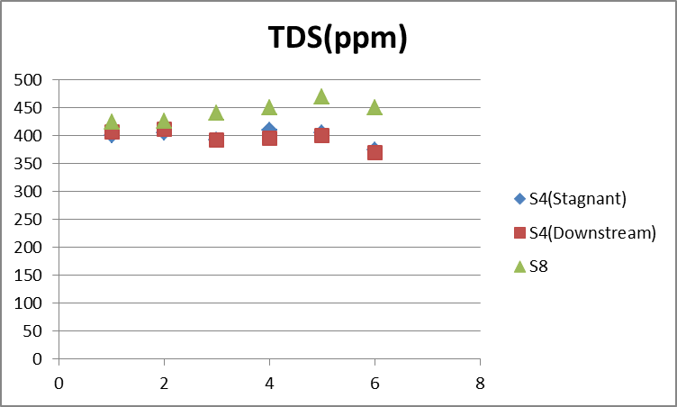
Results: Total Dissolved Solids

Slide 25
Discussion: TDS Results
Site 4: No notable difference between
stagnant pool and downstream
Site 8: Consistently higher TDS content
than Site 4
TDS content slightly lowered after rain event
TDS trend of increasing content during transit through urban environment

Slide 26
Results: Biochemical Oxygen Demand

Slide 27
Discussion: B.O.D. Results
Site 4: First 3 data sets showing difference
between stagnant pool and downstream
Site 8: Consistently higher B.O.D.
B.O.D. lowered slightly in conjunction with rain event
B.O.D. trend of increasing oxygen consumption during transit through urban environment

Slide 28
Discussion: Possible Future Investigation
Dissolved Solids: Ion Chromatograpy? XRF? (Element specific changes during transit through urban environment)
Phosphate, Nitrate, Chlorine, other compounds…
Concentration correlations with biodiversity?
(what differences in organisms are observed, and are these differences related to change in water quality characteristics?)

Slide 29
Conclusion: Urban vs. Rural Surficial Water Quality Variability of Dry Run Creek
Urban areas have a strong ability to alter water quality characteristics
Observed differences in T, pH, TDS, D.O., B.O.D.
Future study: TDS increase-> What exactly is being added during urban transit?

